Slide 1



Gee Whiz Education Toolkit for FCC
www.geewhizeducation.com
www.geewhizeducation.com

Slide 2

Increasing Quality
At Gee Whiz, our goal is to bring quality and equity to family child care.
State Alignment Documentation
Meeting, and exceeding, state and national ECE standards is crucial for success. Find your state alignment documentation as well as links to your state’s ECE standards on this helpful page: https://geewhizeducation.com/state-alignments/
Understanding the 10 Developmental Areas
It is critical for family child care providers to not only understand the 10 developmental areas but also how to address them in their program. This section from the Gee Whiz User’s Guide explains each developmental area in a format that is easy for providers to absorb and incorporate into their daily experiences for children: https:// geewhizeducation.com/wp-content/uploads/2021/07/Developmental-Areas-Learning- Indicators.pdf
Enhancing the Learning Environment
Providers need to understand their role in the learning environment. Our helpful booklet, “The Learning Environment” is designed to help providers gain knowledge in this area: https://geewhizeducation.com/learning-environment/. The skills promoted in this booklet are designed to help providers increase their scores on commonly utilized Environmental Rating Scales (e.g., CLASS® and FCCERS-3).
Individualization & Assessment
Quality programs for children individualize based on needs and interests. A large section of our User’s Guide (training manual) is dedicated to this topic: https://geewhizeducation.com/wp- content/uploads/2021/07/Individualization-and-Authentic- Assessment.pdf Topics covered include anecdotal notes, reflections and observations. Please see the next page for details on the components included in the Gee Whiz curriculum that address this important area.
www.geewhizeducation.com
www.geewhizeducation.com

Slide 3

Assessment and Individualization
Components included in
the Gee Whiz Curriculum
At Gee Whiz, we understand the importance of individualization and authentic assessment. That is exactly why we built components into our curriculum to help providers achieve these goals.
Individualization Web (see page 9) This component helps providers
individualize each Gee Whiz unit based on the children’s individual needs/ interests. If you would like a blank Individualization Web, please see the Individualization section of our User’s Guide (link on p. 2)
Customized/Individualized Lesson Planning Sheet (see page 10)
This component helps providers plan individualizations for each unit.
Connecting the Dots Component (see page 11)
This component helps providers connect specific skills to Gee Whiz experiences. A great tool for helping providers connect activities to their chosen formal child assessment.
www.geewhizeducation.com
www.geewhizeducation.com

Slide 4
Engaging Families & Embracing Diversity
The research is clear… families need to be involved and engaged from the very beginning. Here are resources we provide to help providers better understand the importance of family involvement and engagement as well as the importance of embracing diversity.
Parent Involvement & Family Engagement Document: This booklet contains a wealth of information about the importance of family/parental involvement and family engagement. http://geewhizeducation.com/wp-content/uploads/2020/07/Parent- Involvement-Family-Engagement.pdf
Blog Posts:
Numerous Gee Whiz blog posts are designed to be shared with parents/guardians. For instance, “Better Thinking…More Questions” and “Pick the Right Toy to Promote Creativity.” Here is a link to all of the current Gee Whiz blog posts: https:// geewhizeducation.com/blog/
Exploring Diversity Webinar:
This recorded webinar explores the importance of embracing diversity in any early childhood program. A PowerPoint presentation slide deck and Post Assessment are available to specialists for this webinar. Please click the link to visit our Training Webinar page and download the materials for, or watch, this webinar: https:// geewhizeducation.com/webinar-training/
Cultural & Linguistic Responsiveness:
Quality programs for children incorporate cultural and linguistic responsiveness into their programs. A section of our User’s Guide (training manual) is dedicated to this topic: https://geewhizeducation.com/wp-content/uploads/2021/07/Meeting-the-Needs
-of-All-Children-and-Gee-Whiz.pdf
www.geewhizeducation.com
www.geewhizeducation.com

Slide 5


Family Involvement Components Built into the Gee Whiz Curriculum
Here is a list of components built into the Gee Whiz curriculum that promote family engagement and parental involvement. These are all available in English & Spanish.
Family Letter (see page 12)
All About My Week Report (see page 13)
Digital Family Notes: These unique notes are JPEG files that can be
quickly and easily texted to families (see page 14)
Let’s Read Together! (see pages 15-
16) Providers send home a copy of this simple story for parents/
guardians to read with their children. Available in English & Spanish. Note the open-ended questions added on
the last page of each book.
www.geewhizeducation.com
www.geewhizeducation.com

Slide 6
Training Resources
At Gee Whiz, we recognize the importance of training. That is exactly why we offer FREE webinar training on a wide variety of ECE topics. All webinars are recorded so providers can view them at a time that works in their very busy schedules. You can find all of our recorded webinars on this section of our website: https://geewhizeducation.com/webinar-training/. You can also click below to watch a specific recorded webinar or share with providers. We are also more than happy to share the PowerPoint presentations with Quality Specialists if they want to conduct the training with providers in their agency so providers can attain training credit.
Please email Beth Smith at bsmith@geewhizeducation.com if this is of interest to you.
Webinar Titles:
All About Gee Whiz: https://www.youtube.com/watch?v=Or-q14iX27Y
The ‘Why’ Behind Experiences: https://www.youtube.com/watch?v=J7LE2peuEzg
Learning about Gee Whiz: https://www.youtube.com/watch?v=oYdgBXWutvo
Connecting the Dots: Linking Gee Whiz Experiences with Skills & Assessments: https://
www.youtube.com/watch?v=TRDSyFqg55w
Lesson Planning for a Mixed-Age Group: https://www.youtube.com/watch?v=G55O12kD9ug
Making Math Meaningful: https://www.youtube.com/watch?v=_P4BTLFt96g
No Money? No Problem! Creating Learning Opportunities from Household Materials: https:// www.youtube.com/watch?v=ZfS_60ebAio
Using the Gee Whiz Curriculum with Fidelity: https://www.youtube.com/watch? v=qphrmMH8ji8
What? Why? How? The Power of Open-Ended Questions: https://www.youtube.com/watch? v=KEQJsmwMYhg
Exploring Diversity: https://www.youtube.com/watch?v=jEe8WK_WOSk
www.geewhizeducation.com
www.geewhizeducation.com

Slide 7

Training Resources
In addition to the recorded webinars our User’s Guide contains a wealth of information that can be used for training.
Gee Whiz User’s Guide:
This extensive document includes information on a variety of important topics. Many of these sections could be used as the basis for training. Simply click on the topic of interest to you and the section of the User’s Guide dedicated to that topic will open. You can also download the entire document by following this link: https://geewhizeducation.com/wp-content/ uploads/2021/07/20212022GeeWhizUsersGuidefinalv1.pdf
Your Role
Individualization & Authentic Assessment Developmental Areas & Learning
Indicators (skills)
Meeting the Needs of ALL Children Planning Your Day
www.geewhizeducation.com
www.geewhizeducation.com

Slide 8
Building Your Own Gee Whiz Cohort
Agencies across the country are now using Gee Whiz as a “building block” for their family child care cohorts or networks. Getting started is easy! If you are interested in purchasing Gee Whiz for your family child care providers or simply looking for ways to help new providers get started with the curriculum, we are here to help!
How to Purchase Multiple Subscriptions
If you are interested in establishing a cohort and purchasing multiple subscriptions for providers, we are here to help! Please contact Sherry Mayberry (smayberry@geewhizeducation.com) with the following information if you would like a price quote:
Your name & title
Agency name
Number of quarterly or yearly subscriptions you would like to purchase
Date you would like subscriptions to begin and end
When you are ready to purchase, Sherry will also need a complete list of all providers that includes their full name and email address. This information is required in order to set up each provider’s account. You can either pay with an agency credit card or send a check to us.
Helping New Providers Get Started with Gee Whiz:
Simply share this document with new providers. It includes screenshots to help them learn how to log in, access and download the monthly unit files: https:// geewhizeducation.com/wp-content/uploads/2020/10/ howtoaccesstheGeeWhizcurriculum2020.pdf
Learning about Gee Whiz Webinar:
Invite all new providers to watch this recorded webinar about how to use the curriculum. We also offer this webinar live at many times during the year. https:// www.youtube.com/watch?v=oYdgBXWutvo
www.geewhizeducation.com
www.geewhizeducation.com

Slide 9
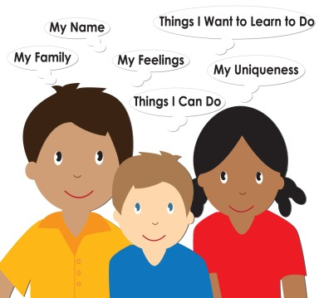
Individualization Web
Sample Individualization Web
Child’s Name: Child’s Interest or Area of Focus: | Monthly Unit Title & Topics: All About Me My Name Makes Me Special I Am Unique in Many Ways My Feelings Make Me Special I Can Do Many Things
Child Response to the Question - What would you like to learn about ?
Activities Planned:
Reflection:
www.geewhizeducation.com

Slide 10
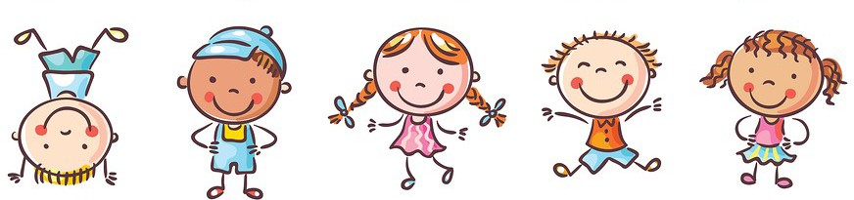
Sample Customized/Individualized Lesson Planning Sheet
This component is 5 pages in length and is included with each Gee Whiz unit. We provide a Word version (where providers can type in the boxes) and a PDF version. There is space on each page to record individualizations for up to 6 children. The sample below (completed) only includes columns with individualizations for one day for 3 children so it is easier for you to read. In the sample, we used abbreviations for the names of the activities planned during the day. For instance, WAMF stands for “Who Are My Friends?”
8/1/21 to 8/12/21
Beth Smith
 | Child’s Name: Trena | Child’s Name: Jamie | Child’s Name: Raul
DAY 1 (pgs. 4-5) Exploring Together: Who Are My Friends? Center/Small Group: Find Your Name Game Center/Small Group: Fun with Friends Infant: I See a Friend Additional Activities Planned: | WAMF: Hold Trena and help her roll the ball. FYNG: Put stickers on Trena’s cards for her to match instead of her matching her printed name. FWF: Describe the “friend blocks” Trena chooses to help her build receptive vocabulary. | WAMF: Make sure to use a large ball that is easier for Jamie to handle. FYNG: Pair Jamie with Raul when playing the game. FWF: Make sure Jamie has larger “friend blocks” that are easier for him to handle. | WAMF: Have Raul assume a leadership role when playing the game by inviting him to help lead the song. FYNG: Encourage Raul to identify the letters in his name as he finds his name cards. FWF: Invite Raul to make additional “friend blocks” using old magazines and/or art supplies.
www.geewhizeducation.com

Slide 11

Sample Connecting the Dots Component
Each Connecting the Dots component is 16 pages in length. It shows providers, at a glance, how all 40 of the Gee Whiz Indicators (skills) are addressed during the unit. This makes it very easy for providers to quickly identify which experiences planned in the Gee Whiz unit address the skills they need to evaluate, reinforce, etc. This makes it much easier for providers to complete their chosen formal assessments.
LEARNING INDICATORS (specific skills) | These experiences address Language Development 
LD1 - Understands spoken language Objectives/ Skills on my formal child assessment that correlates to this skill are: | Who Are My Friends? (p. 4) Find Your Name Game (p. 5) Fun with Friends (p. 5) I See a Friend (p. 5) I Care! (p. 6) I Will Take Care of You (p. 7) Building a Word (p. 7) My Friends Like to… (p. 7) Do You Need Help? (p. 8) Friends Fingerprint Mural (p. 9) Mixed-Up Puzzles (p. 9) More Photo Fun! (p. 9) We Can Share (p. 10) Water and Sharing (p. 11) To Share or Not to Share (p. 11) Let’s Share (p. 11) | Everyone is Included (p. 12) Water Fun for Everyone (p. 13) Mixing and Making Together (p. 13) Read Me a Story (p. 13) R.E.S.P.E.C.T. (p. 14) I Am Respectful Crowns (p. 15) Respectful Bubble Fun (p. 15) Peek-a-Boo (p. 15) My Friend Feels… (p. 16) Find a Feeling (p. 17) Feelings and Fingerpaint (p. 17) If You’re Happy (p. 17) Alike and Different (p. 18) Paper Plate Self- Portraits (p. 19) Choosing Activities (p. 19 | Who is That? (p. 19) Perfect Pen Pals (p. 20) Pen Pal Writing Station (p. 21) Off to My Friend’s House (p. 21) Letters In. Letters Out. (p. 21) Friendship Day (p. 22) Elbow Bump Dance (p. 23) A Friendship Chain (p. 23) So Many Songs (p. 23) An Alphabet of Friends (p. 24) A Snack to Share (p. 24) Pass the Hula Hoop (p. 25) How Do You Show Respect? (p. 25) I Feel... (p. 26) Likes and Dislikes Posters (p. 26) | Additional experiences I planned to address this skill:
www.geewhizeducation.com

Slide 12











Our next unit is a very important one because it focuses on an extremely important topic… the children! “All About
Me” is a unit designed to help the children become more aware of their own uniqueness. In addition, the children will have the opportunity to explore their feelings, families and much more. Here are a few of the main concepts we will
explore during this unit:
My Name Makes Me Special
My Feelings Make Me Special
I Try Hard to Learn New Things
Families Take Care of One Another
I Am Unique in Many Ways
I Can Do Many Things
Families Are Unique
Families Take Care of Their Homes
Here are some activities you can do with your child at home that reinforce our unit, “All About Me.”
Bathtime: When bathing, talk with your child about why it is important to keep his/her body clean. | Mealtime: Invite your child to help prepare a favorite food for dinner or a snack.
Out & About (Traveling): Look for different types of homes when riding from place to place. Talk about how different families live in different types of homes. | Bedtime: Read books and talk about how the characters are feeling in the story. Do their feelings change? Why?
Sing the song, “I Am Me!” with your child and talk about your likenesses and differences.
I AM ME!
(tune: “Twinkle, Twinkle, Little Star”)
I am me and you are you. We’re both special...this is true.
Some things we like are the same. Others are different and that’s OK!
I am me and you are you.
We’re both special...this is true.
www.geewhizeducation.com

Slide 13
Sample All About My Week Report
All About My Week
Name: _ Date:
This week, the activity I enjoyed most was:
_
_
These reports are designed to go home at the end of the week. There are 2 reports for each unit. They are also available in both English & Spanish.
This week, I spent a lot of time playing with:
art materials
sand
blocks
play food
playsets
books
water
riding toys
dolls
balls
toy vehicles
puzzles
toy/plush animals
dress-up clothes
playdough
We encourage providers to make copies of the completed reports before sending them home to add to each child’s portfolio.
other
I am trying very hard to learn how to:
_
_
_
I am getting very good at:
_
_
_
www.geewhizeducation.com

Slide 14




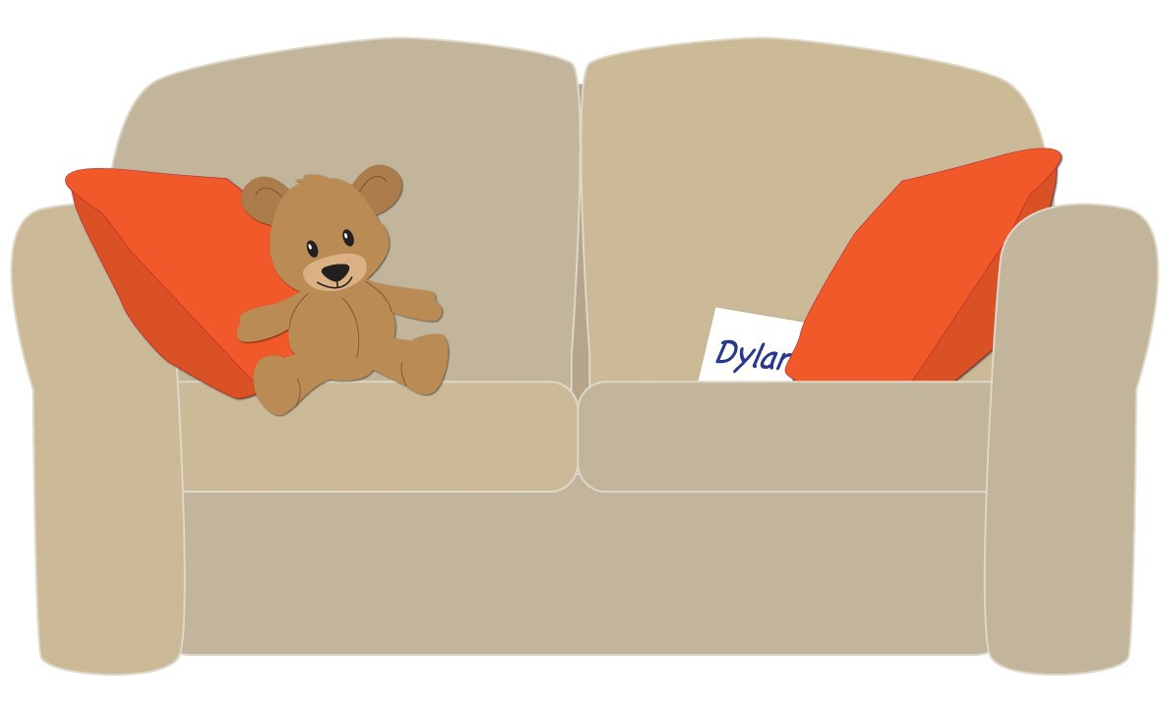
Sample Digital Family Notes
These are JPEG files that providers can download and then text or email to parents/guardians. They are available in English & Spanish (2 per unit)
Looking at family photos with your
child is a wonderful
way for him/her to
build an
understanding of “family.” As you look at photos together,
be sure to use plenty
of language and also ask a lot of questions!
Let’s go on a name hunt! Print your child’s
name on index cards and hide around the
room. Invite your child to “hunt” for the names.
After finding them all,
count to see
how many
names he/she found all
together.
www.geewhizeducation.com

Slide 15
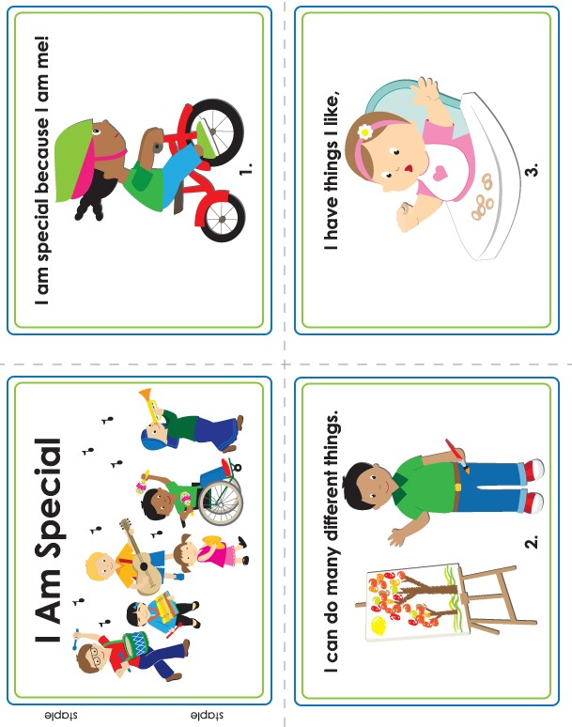
www.geewhizeducation.com

Slide 16
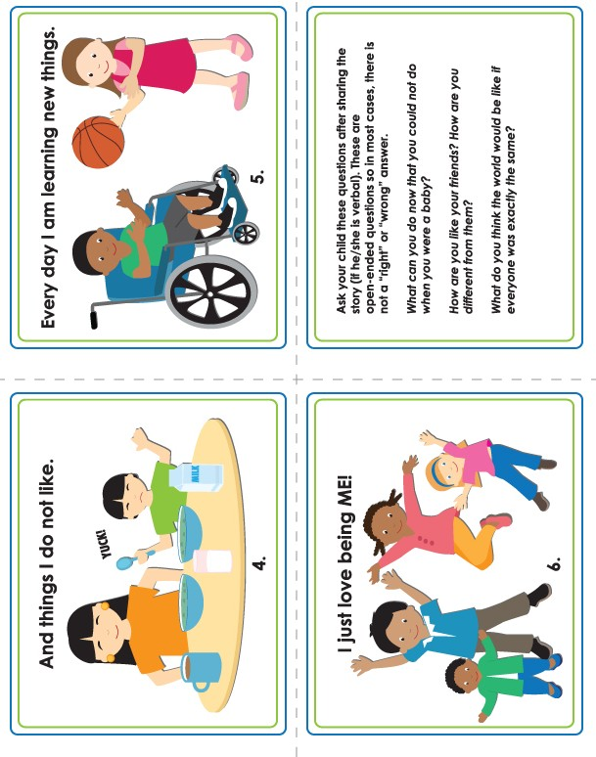
www.geewhizeducation.com

